Slide 1
EDA ASSIGNMENT
A BANK LOAN CASE STUDY

Slide 2
Objective :
EDA Case Study to develop a basic understanding of risk analytics in banking and financial services and understand how data is used to minimize the risk of losing money while lending to customers.
To use EDA to analyze the patterns present in the data.

Slide 3
Data Understanding :
This dataset has 3 files as explained below:
1. 'application_data.csv' contains all the information of the client at the time of application. The data is about whether a client has payment difficulties.
2. 'previous_application.csv' contains information about the client’s previous loan data. It contains the data on whether the previous application had been Approved, Cancelled, Refused or Unused offer.
3. 'columns_description.csv' is data dictionary which describes the meaning of the variables.

Slide 4
Exploratory Data Analysis : Steps Involved
Identifying the data types
Fixing the rows and columns
Imputing/removing missing values
Handling outliers
Standardizing the values
Fixing invalid values
Filtering the data
Data Analysis – Univariate & Bivariate Analysis
Data Visualization

Slide 5
Dataset 1 - application_data.csv
Reading and understanding dataset
Importing the dataset
Checking the information of all rows and columns
Checking numeric and categorical variables
Checking Missing data or null values – fixing null values
Data cleaning and manipulation
Analysis and Visualisation

Slide 6
Observations : 'application_data.csv' - read as Application_data contains all the information of the client at the time of application. The data is about whether a client has payment difficulties or not. Total rows - 307511 Total columns - 122 Few columns have negative values - DAYS_BIRTH (Clients age in days at the time of application) - DAYS_EMPLOYED (How many days before the application the person started current employment) - DAYS_REGISTRATION (How many days before the application did client change his registration) - DAYS_ID_PUBLISH (How many days before the application did client change the identity document with which he applied for the loan) - DAYS_LAST_PHONE_CHANGE & date or days can not be negative - Needs more evaluation Few columns have very high values, mostly amount/credit columns - Needs more evaluation

Slide 7
Null values distribution among 122 columns :
41 columns have more than 50% data missing
13 columns have less than 15 % data missing
10 columns have 15% - 50% data missing
58 columns have no null values
# Its better to drop all the columns having missing values more than 50% (that is 41 columns) as most of the data is missing in these columns

Slide 8
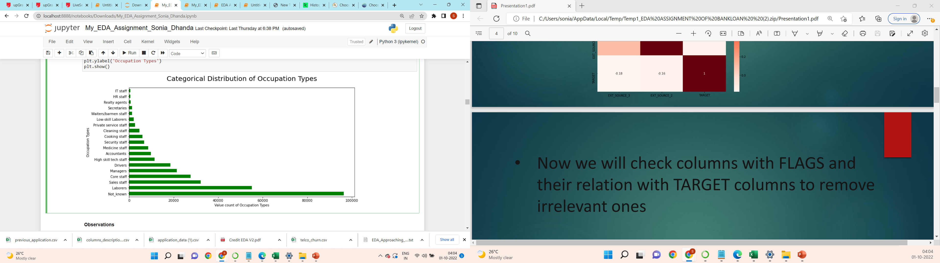
Categorical Distribution of Occupation Types
Observations
Top 3 occupation types categories :
- Maximum number of customers occupation type is not known, hence belongs to unknown category
2) - Second highest one is laborers
3) - Third most common category is Sales staff

Slide 9
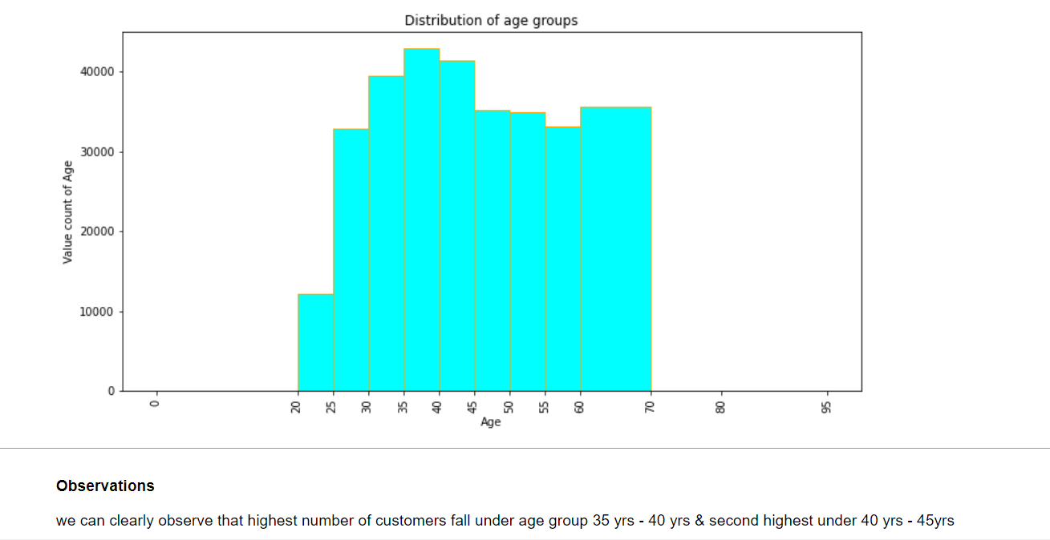
Checking the distribution of age groups

Slide 10
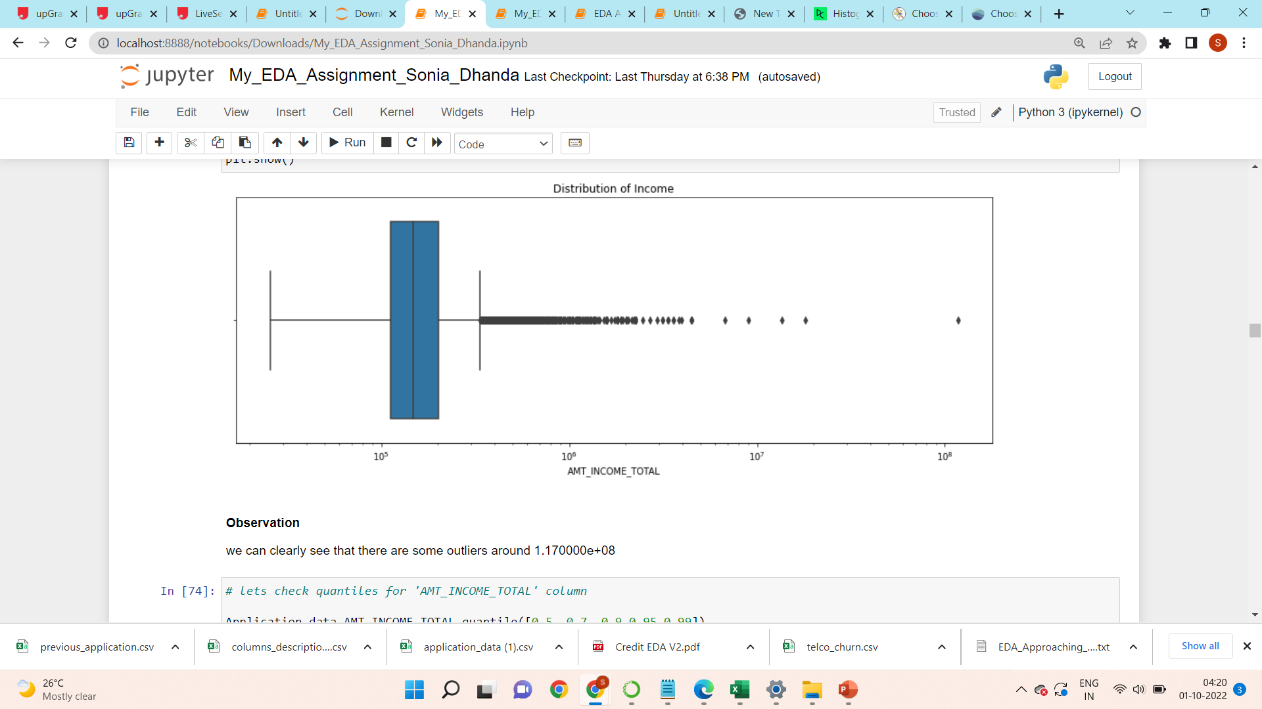
Checking Outliers: Outliers are values that are much beyond or far from the next nearest data points.
Checking for 'AMT_INCOME_TOTAL' column which have information about Income of the client

Slide 11
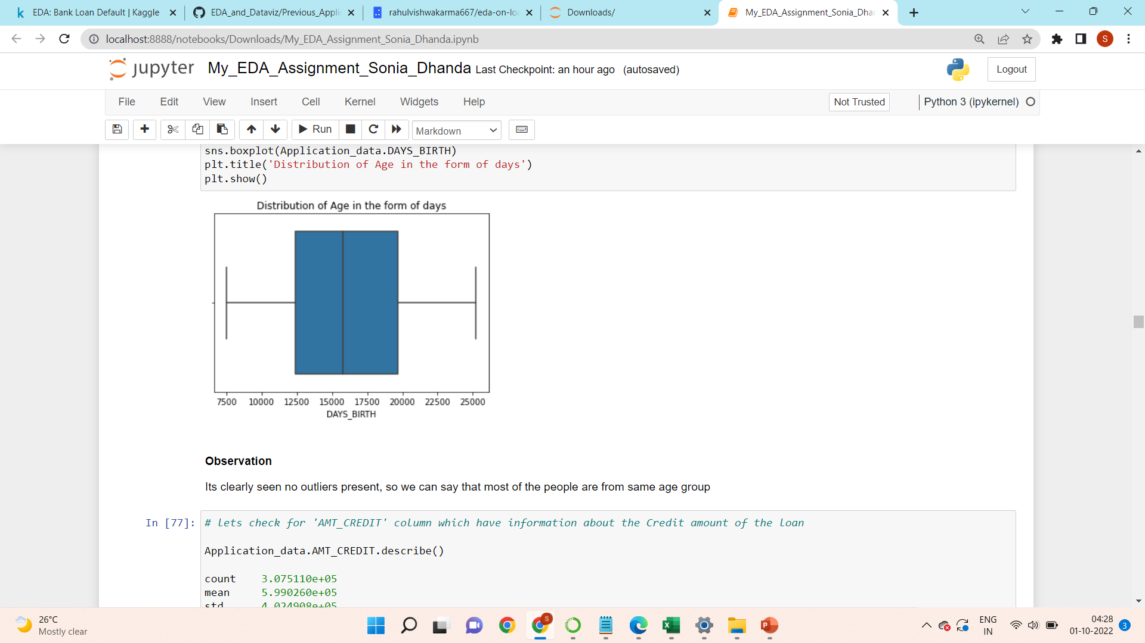
Checking for 'DAYS_BIRTH' column

Slide 12
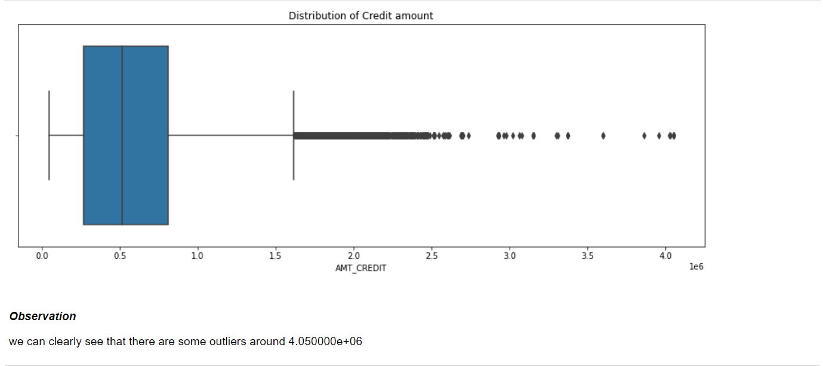
Checking for 'AMT_CREDIT' column which have information about the Credit amount of the loan

Slide 13
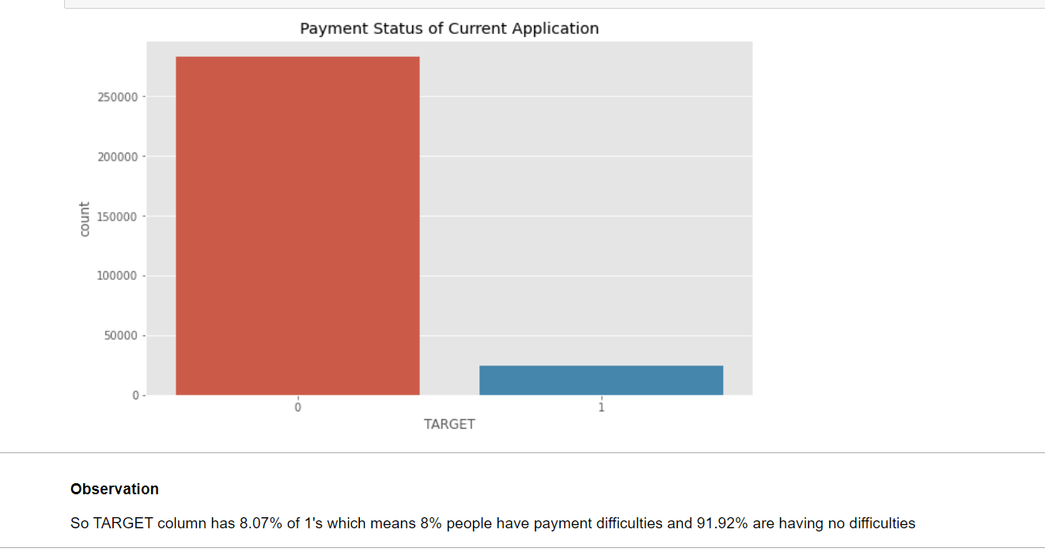
Checking Data Imbalance

Slide 14
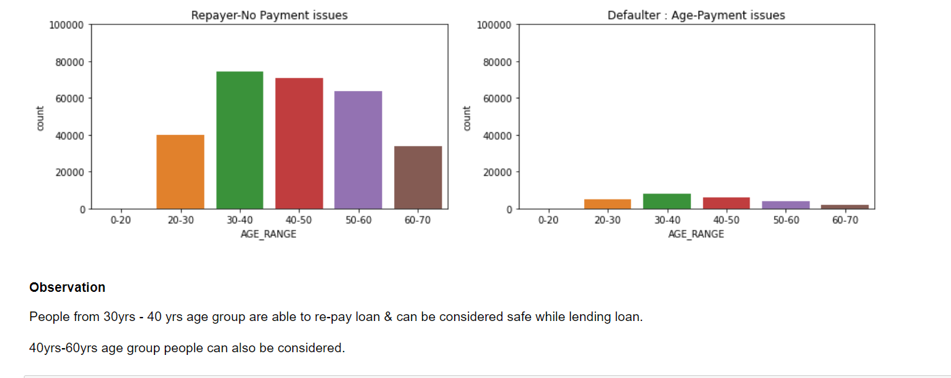
Univariate Analysis

Slide 15
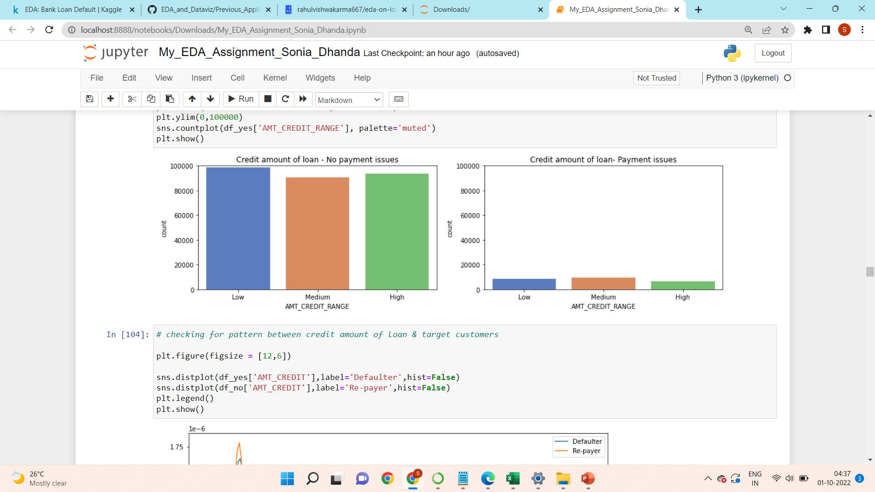
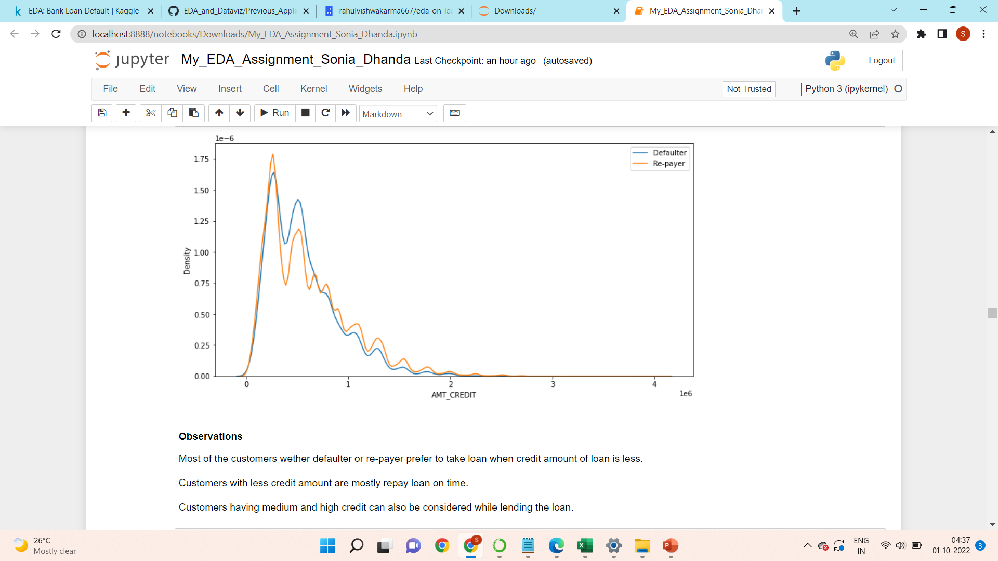
Checking for pattern between credit amount of loan & target customers

Slide 16
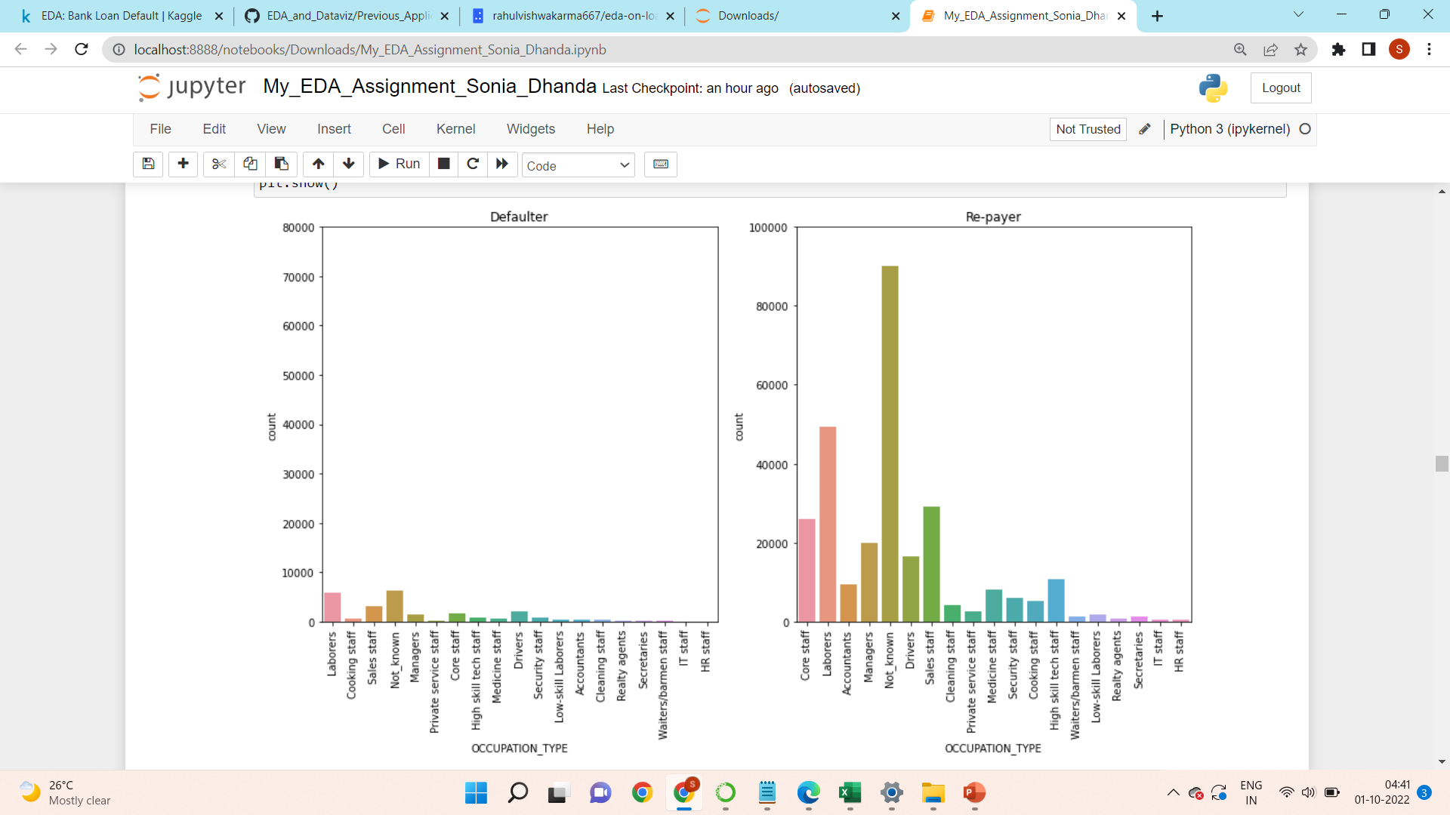
Checking target customer with respect to occupation type
Observations
It clearly shows that occupation of customers that are most likely to make payment on time is not known.
Second highest occupation type is laborer's who are able to repay loan on time.
On the contrary HR staff are less likely to make payment on time.

Slide 17
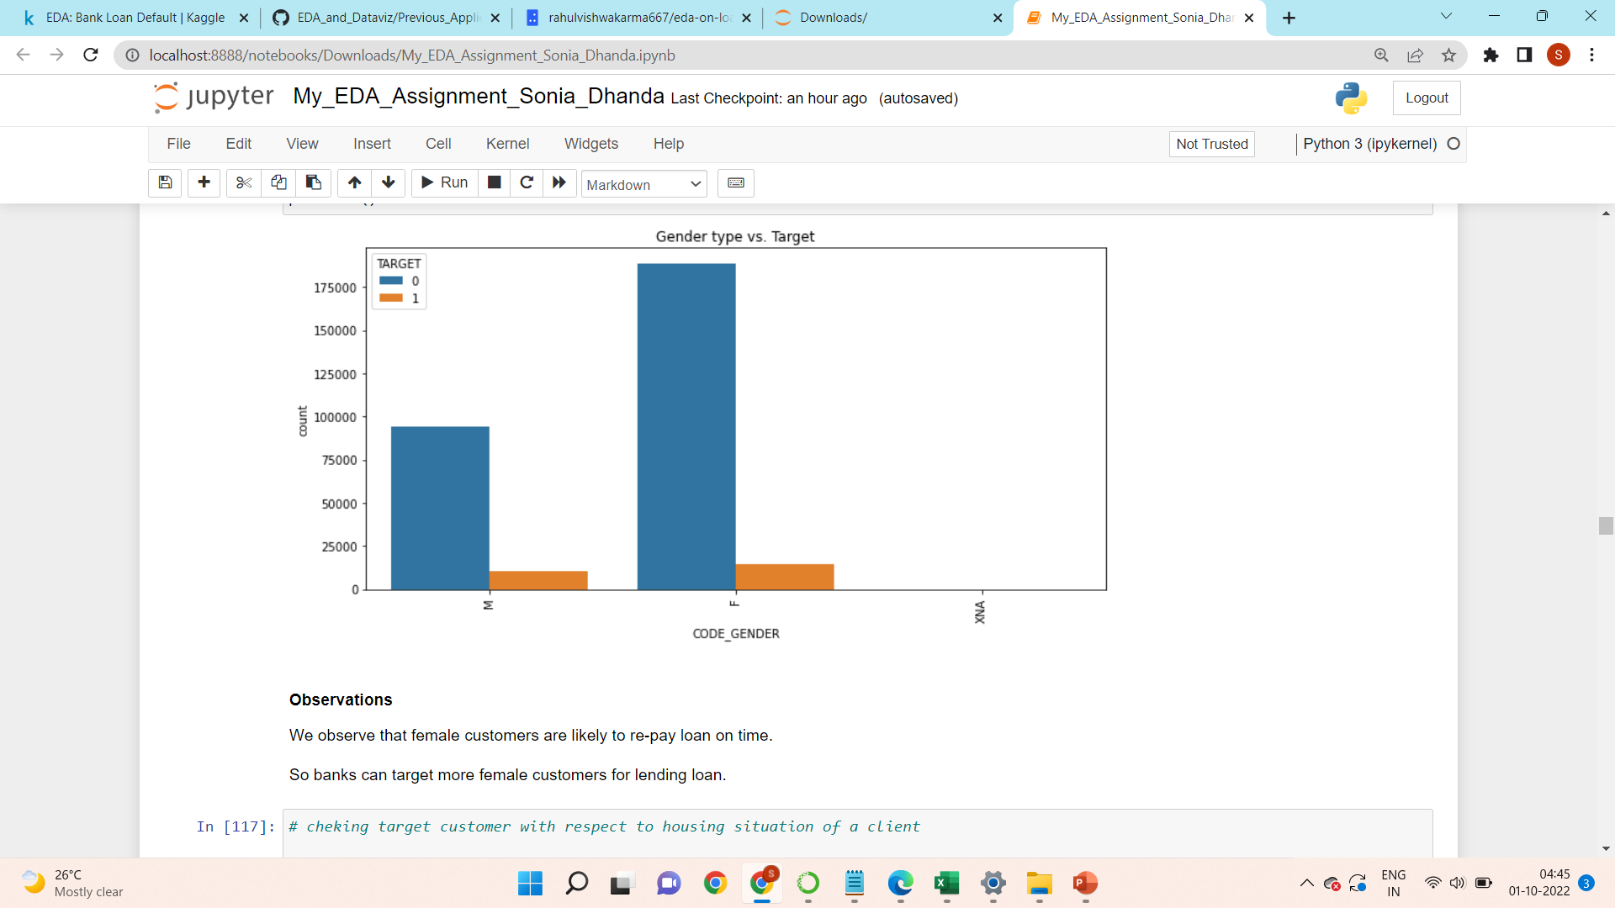
Checking target customer with respect to gender type

Slide 18
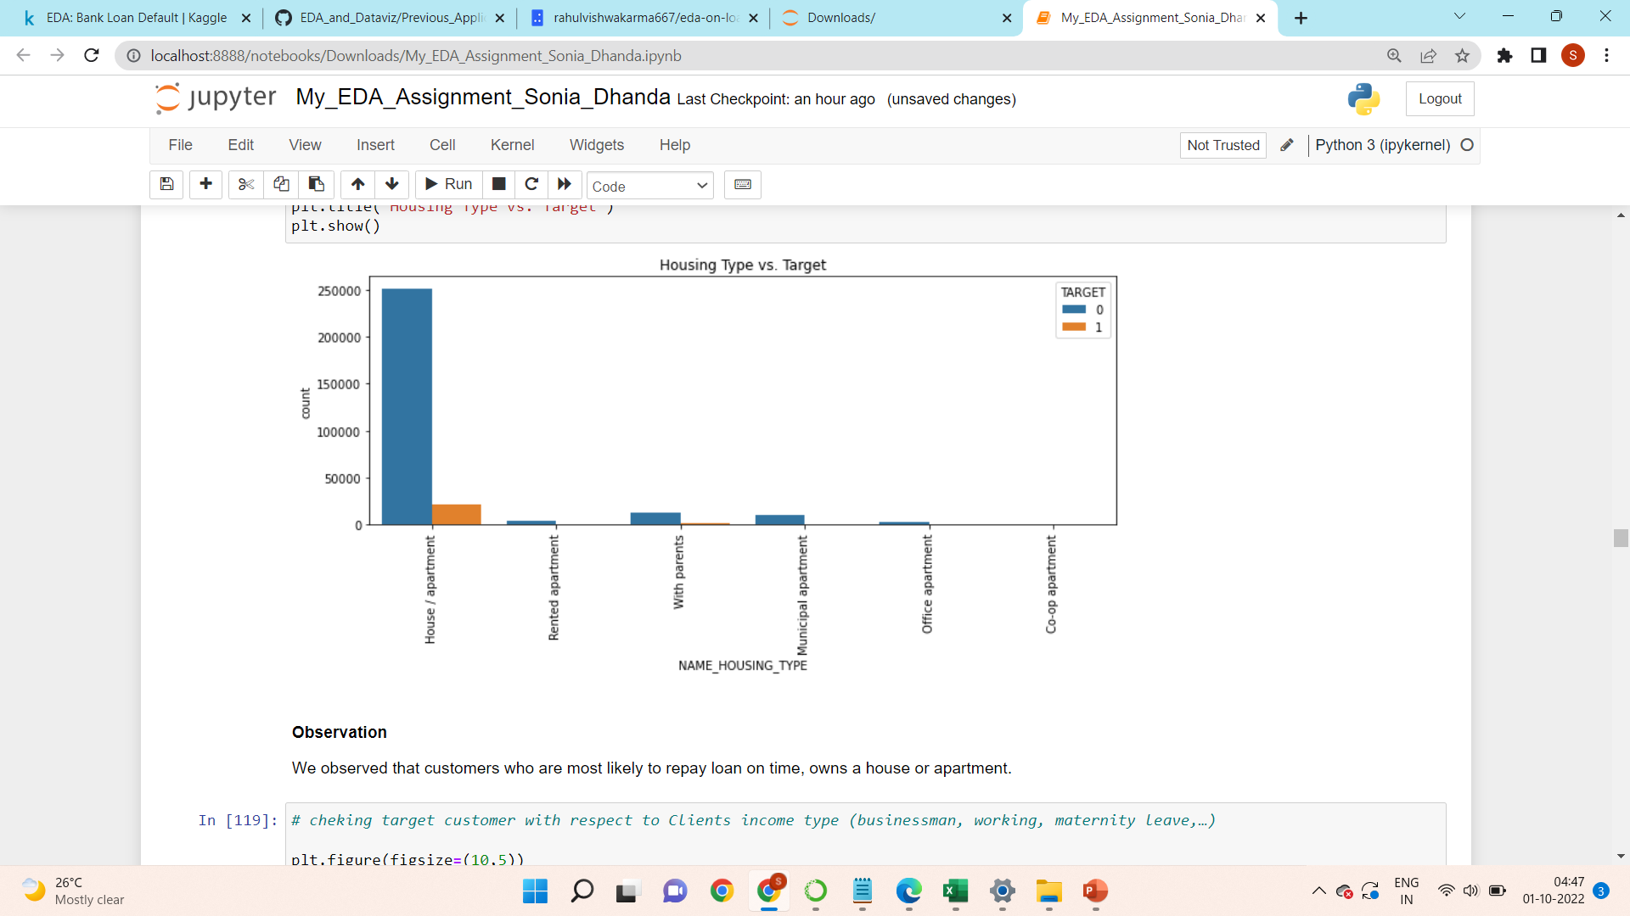
Checking target customer with respect to housing situation of a client

Slide 19
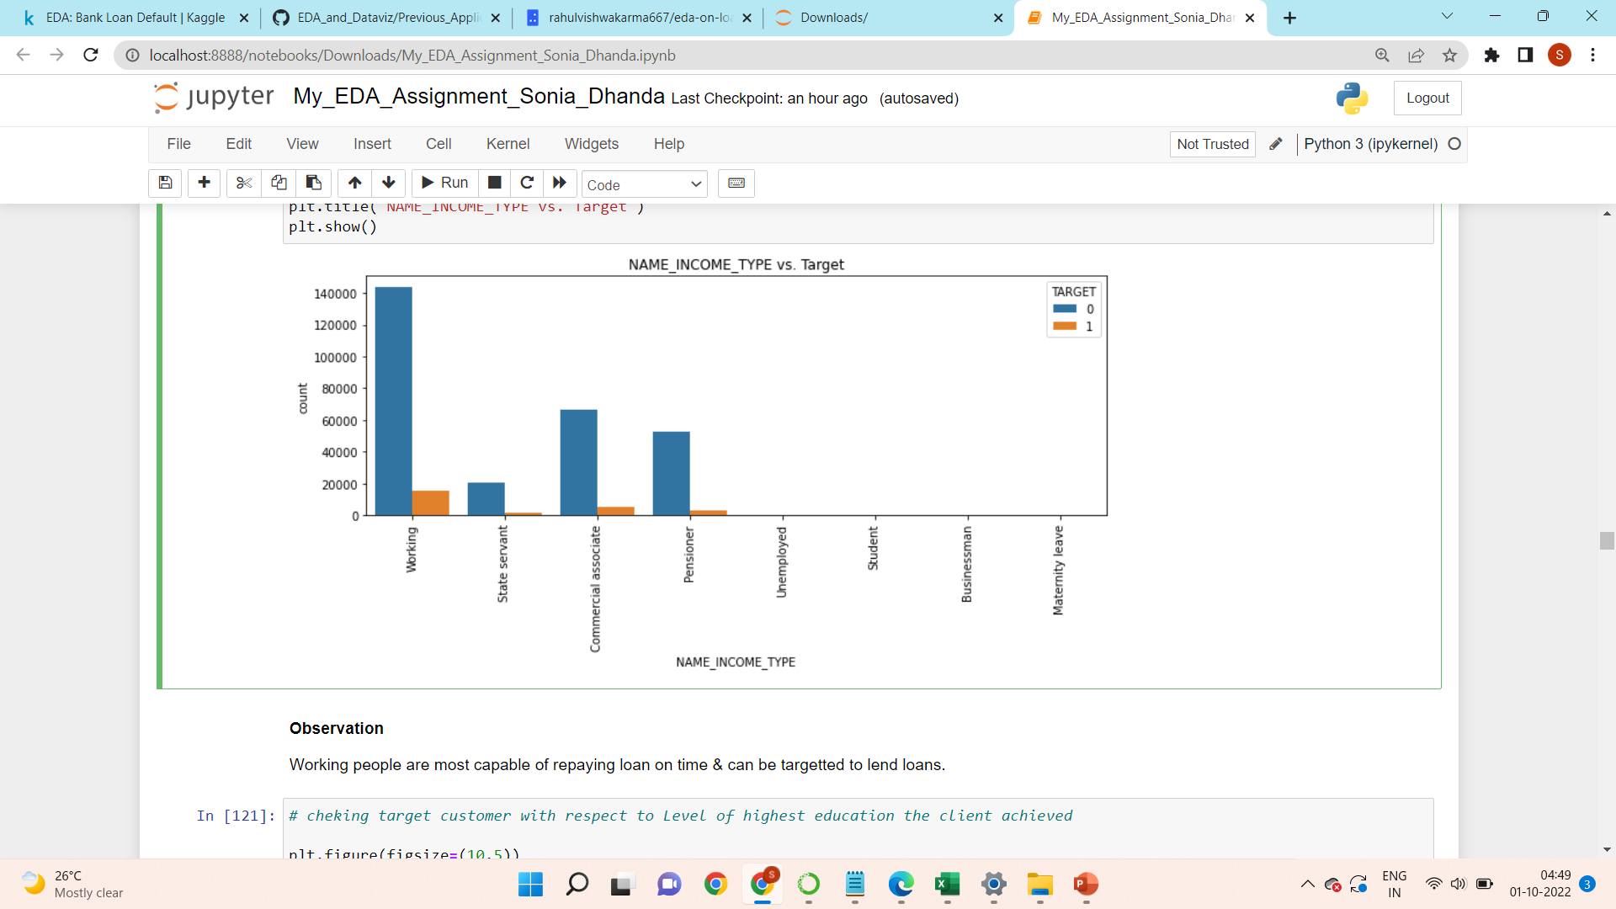
Checking target customer with respect to Clients income type (businessman, working, maternity leave,…)
Observation
Working people are most capable of repaying loan on time & can be targetted to lend loans.

Slide 20
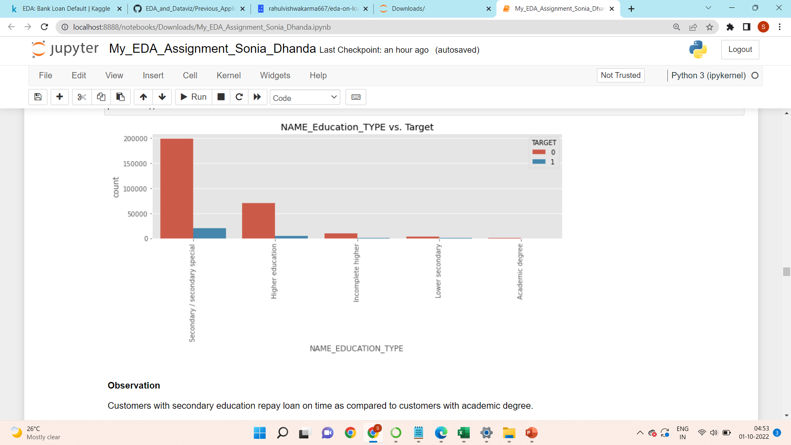
Checking target customer with respect to Level of highest education the client achieved

Slide 21
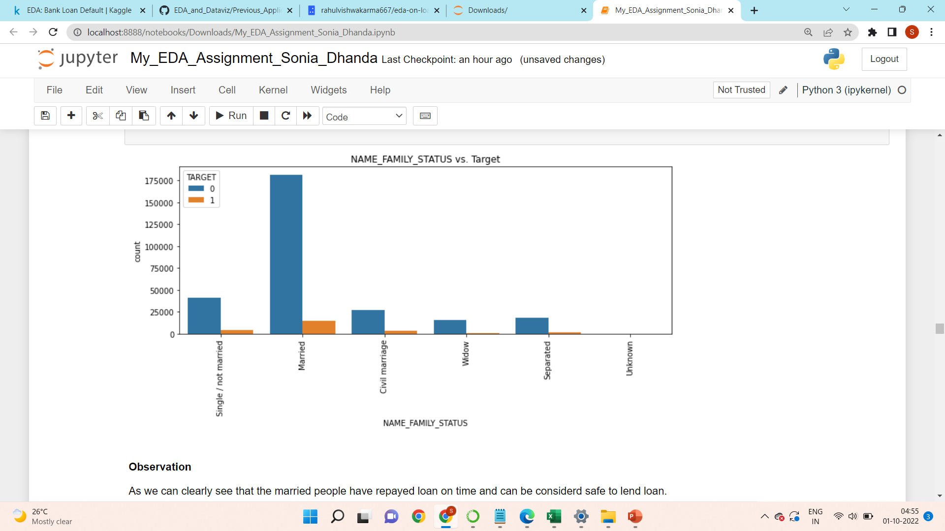
Checking target customer with respect to Family status of the client

Slide 22
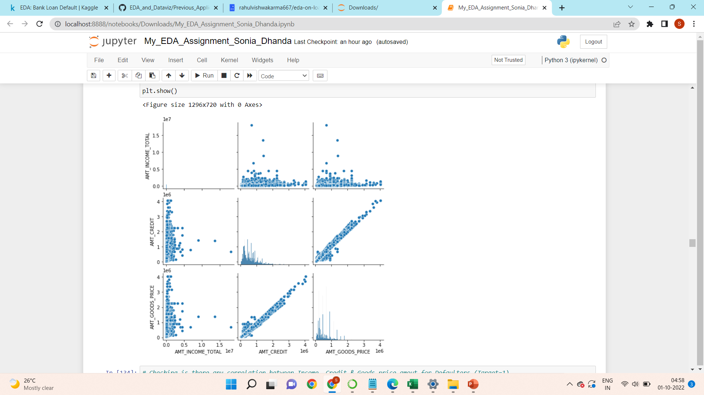
Bivariate Analysis Numeric - Numeric Analysis For numeric-numeric analysis we have 3 options - Scatter plot, Correlation matrix & Pair plot.
Checking is there any correlation between Income, Credit & Goods price amount for Repayers (Target=0)

Slide 23
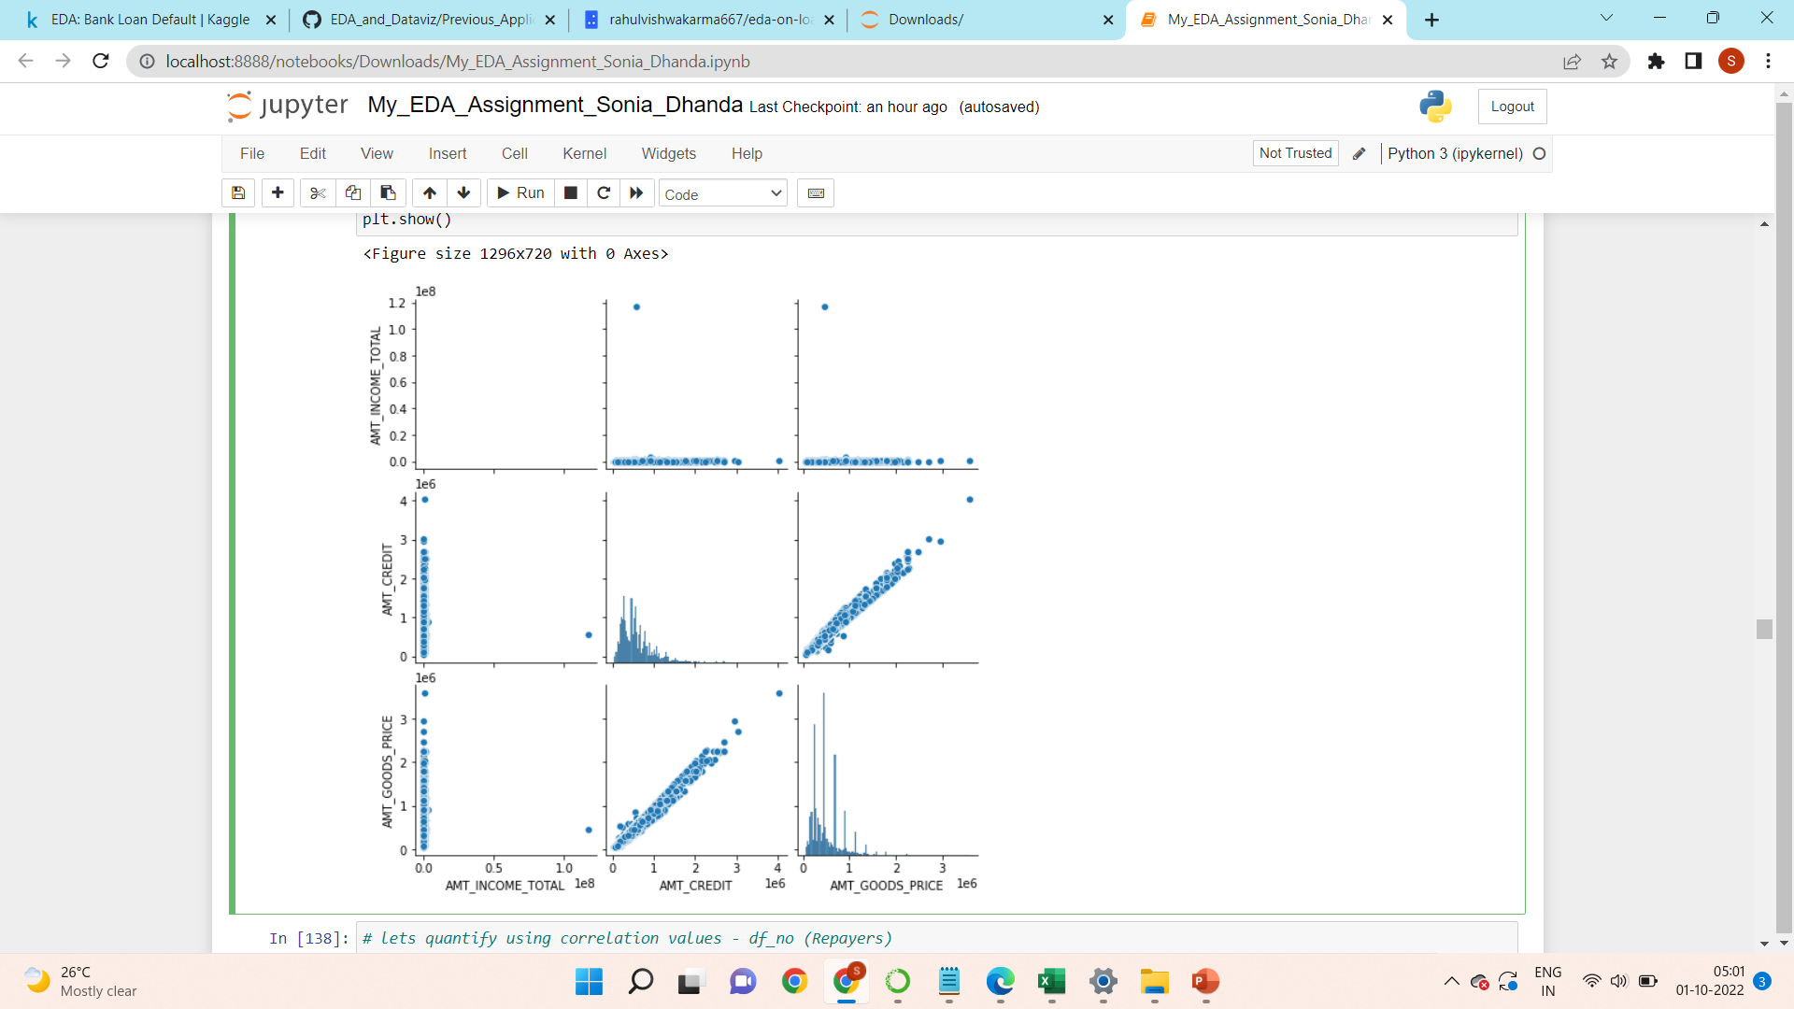
Checking is there any correlation between Income, Credit & Goods price amout for Defaulters (Target=1)

Slide 24
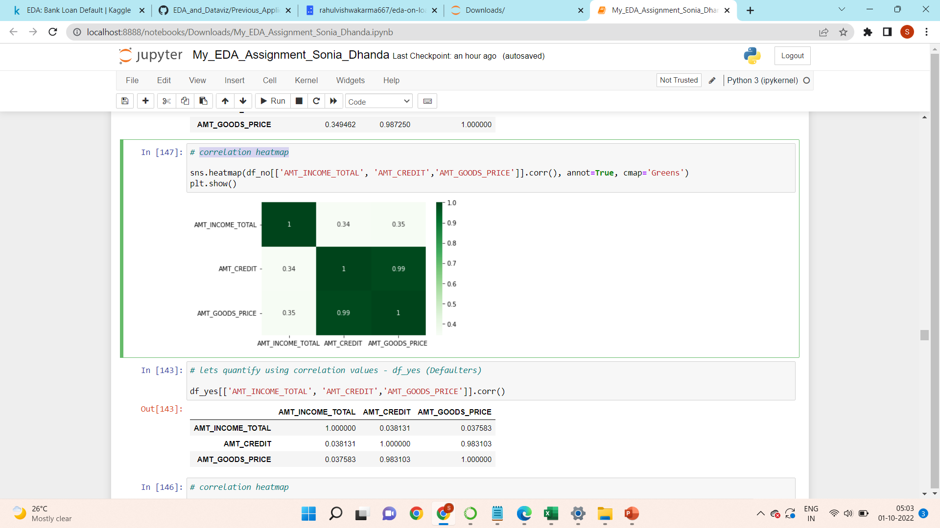
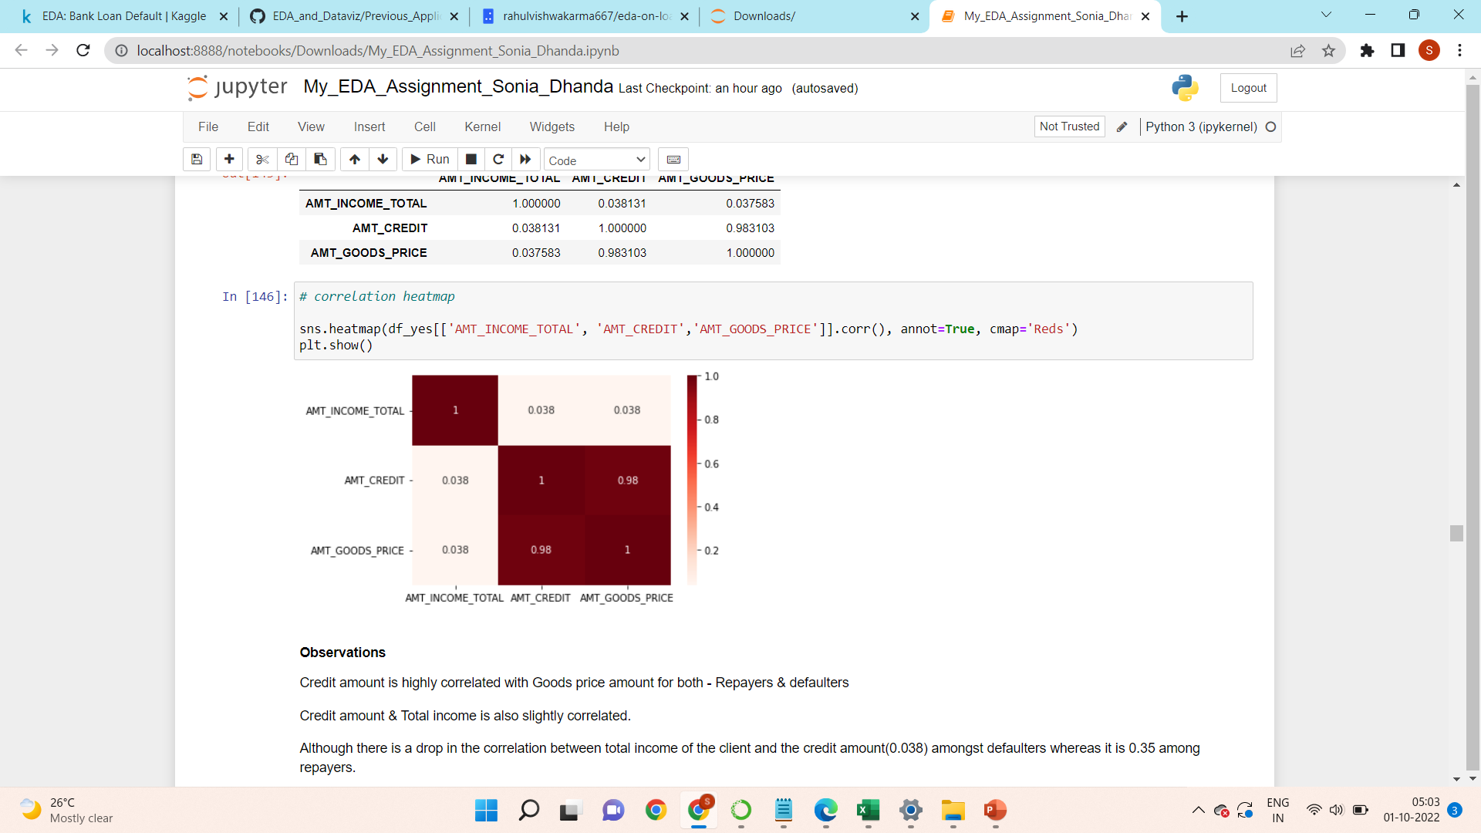
Correlation heatmap
df_no (Repayers)
df_yes (Defaulters)
Observations
Credit amount is highly correlated with Goods price amount for both - Repayers & defaulters
Credit amount & Total income is also slightly correlated.
Although there is a drop in the correlation between total income of the client and the credit amount(0.038) amongst defaulters whereas it is 0.35 among repayers.

Slide 25
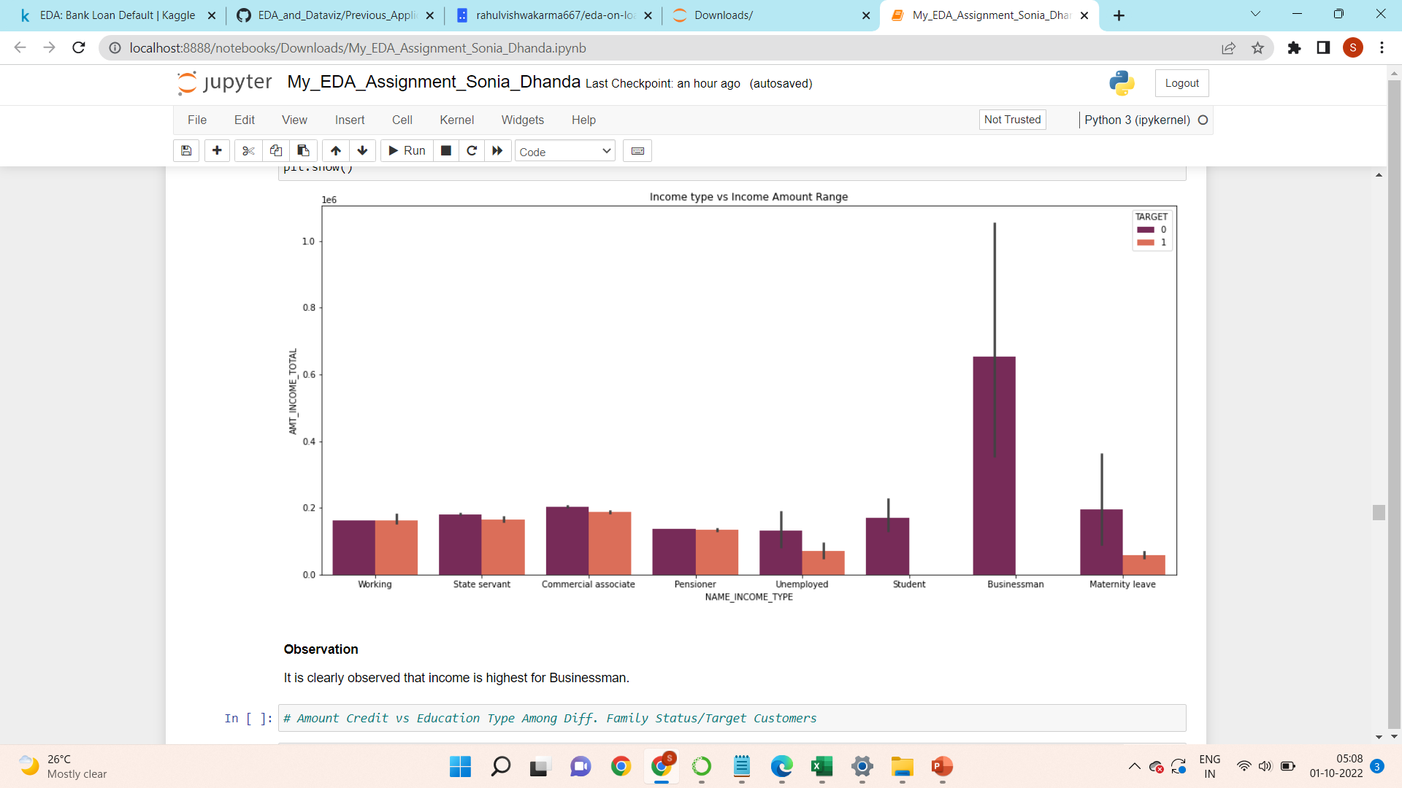
Numerical - Categorical Analysis

Slide 26
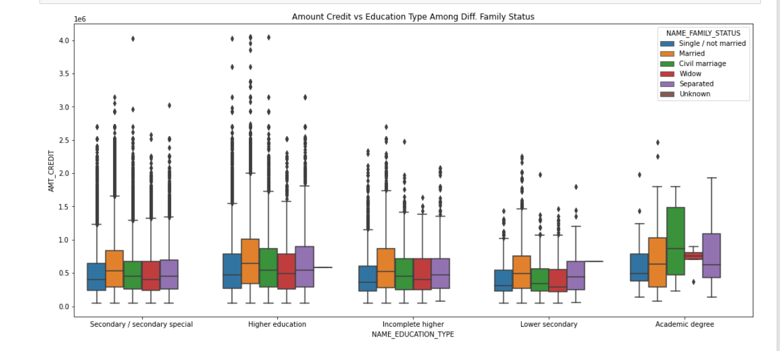
Amount Credit vs Education Type Among Diff. Family Status/Target Customers

Slide 27
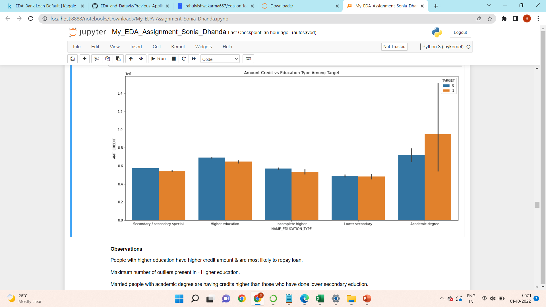

Slide 28
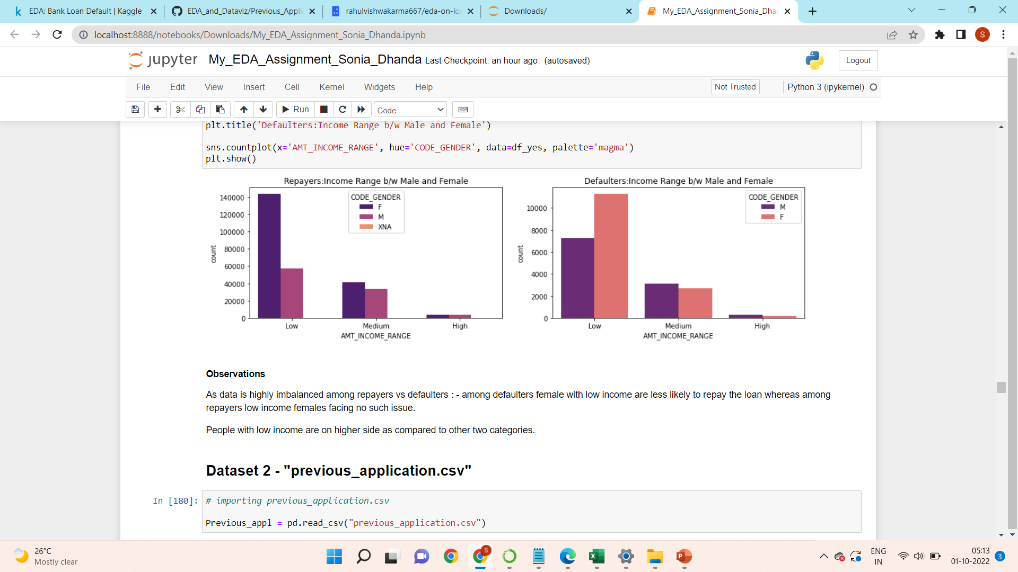
Income Range b/w Male and Female among Repayers & Defaulters

Slide 29
Dataset 2 - "previous_application.csv"
Reading and understanding dataset
Importing the dataset
Checking the information of all rows and columns
Checking numeric and categorical variables
Checking Missing data or null values – fixing null values
Data cleaning and manipulation
Analysis and Visualisation

Slide 30
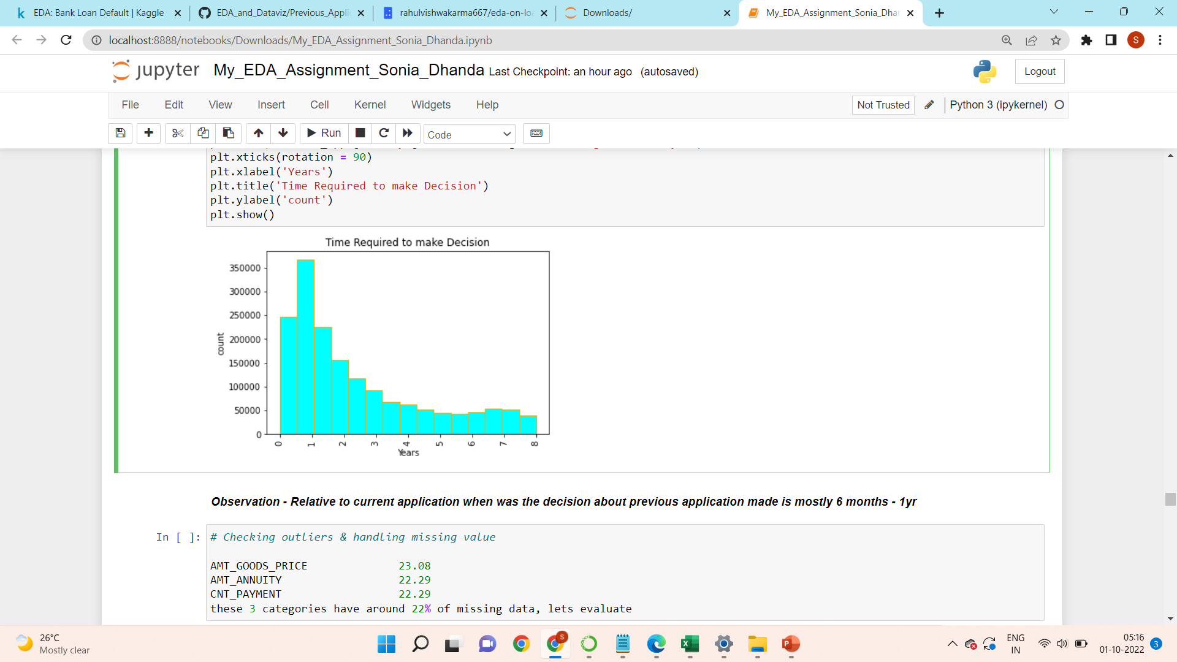
Plotting histogram for DAYS_DECISION

Slide 31
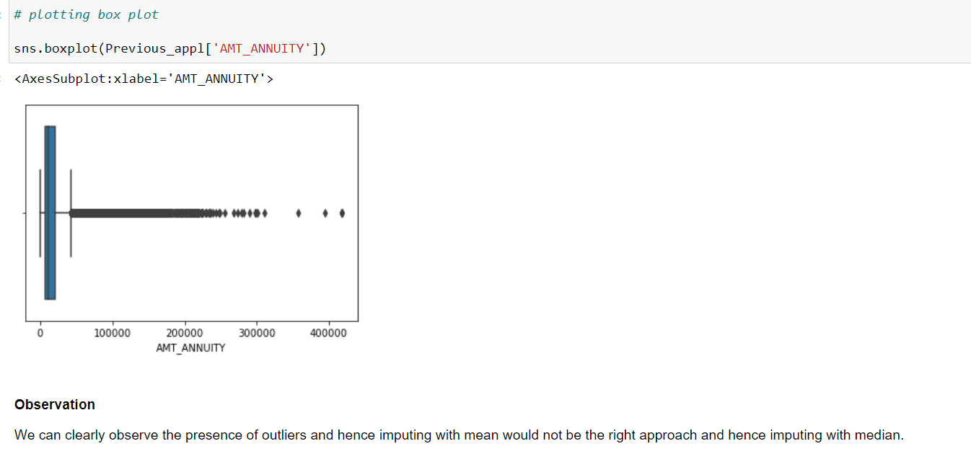

Slide 32
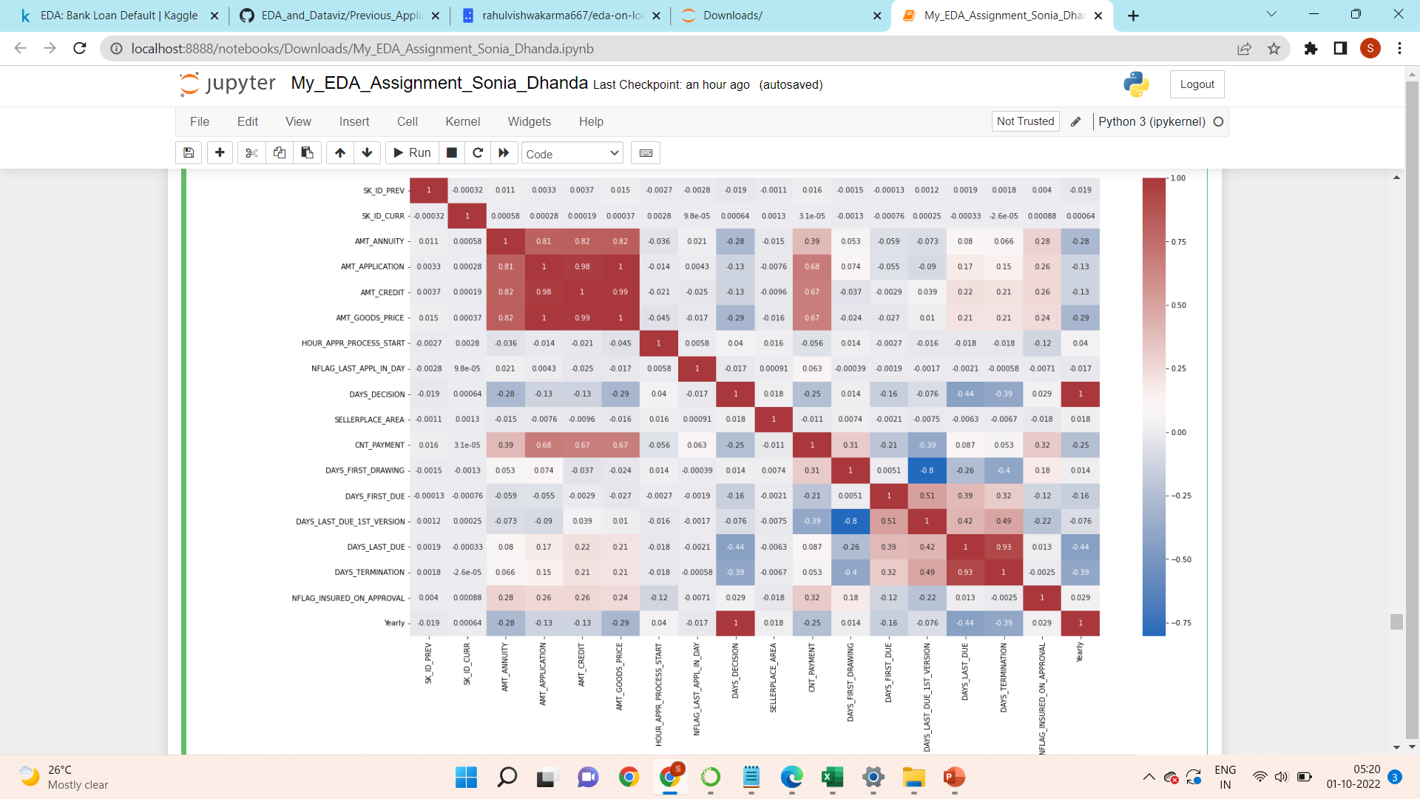
Checking correlation between numeric features of previous application data

Slide 33
Observations
DAYS_LAST_DUE and DAYS_TERMINATION are highly correlated
AMT_ANNUITY',AMT_APPLICATION',AMT_CREDIT',AMT_GOODS_PRICE are highly correlated
DAYS_FIRST_DRAWING and DAYS_LAST_DUE_1st_VERSION have high negative correlation

Slide 34
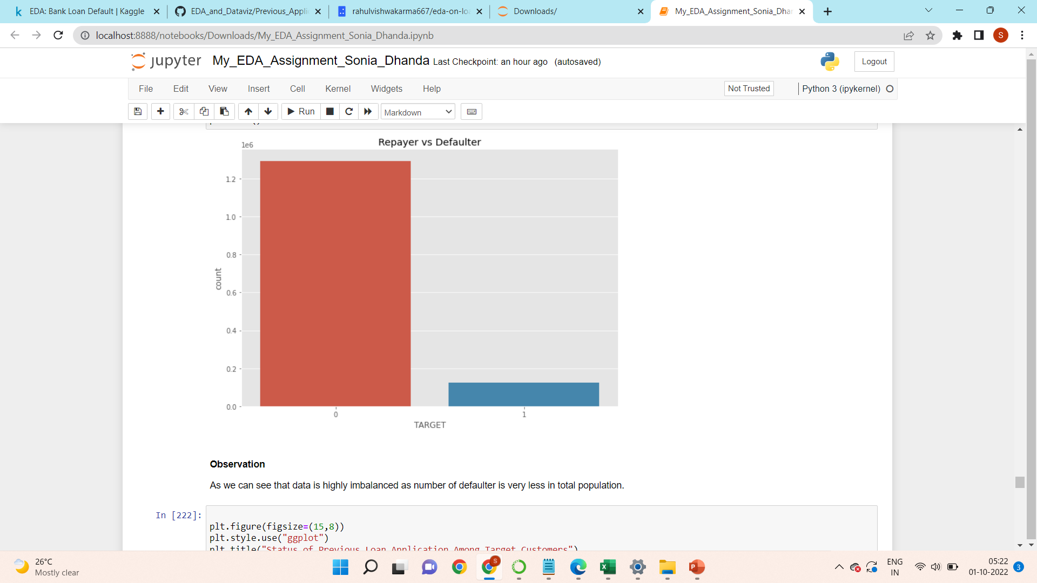
Merging dataframes - Application_data & Previous_appl

Slide 35
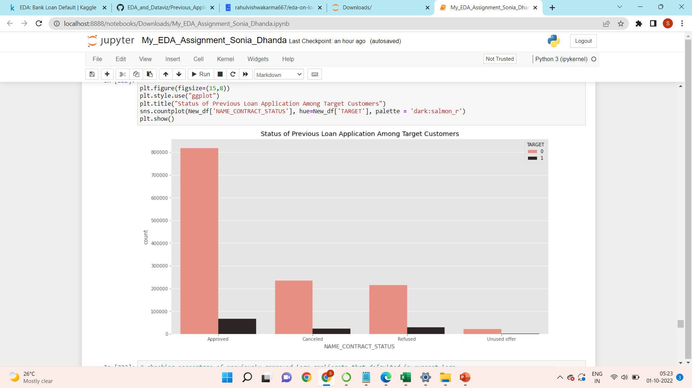
Observations
The people whose previous loans were approved are more likely to re-pay the current loan timely, than the people whose previous loans were rejected.
7% of the defaulters in current loan have previously approved loan applicantion.
88 % of the repayers in current loan have previously refused loan applicantion.

Slide 36
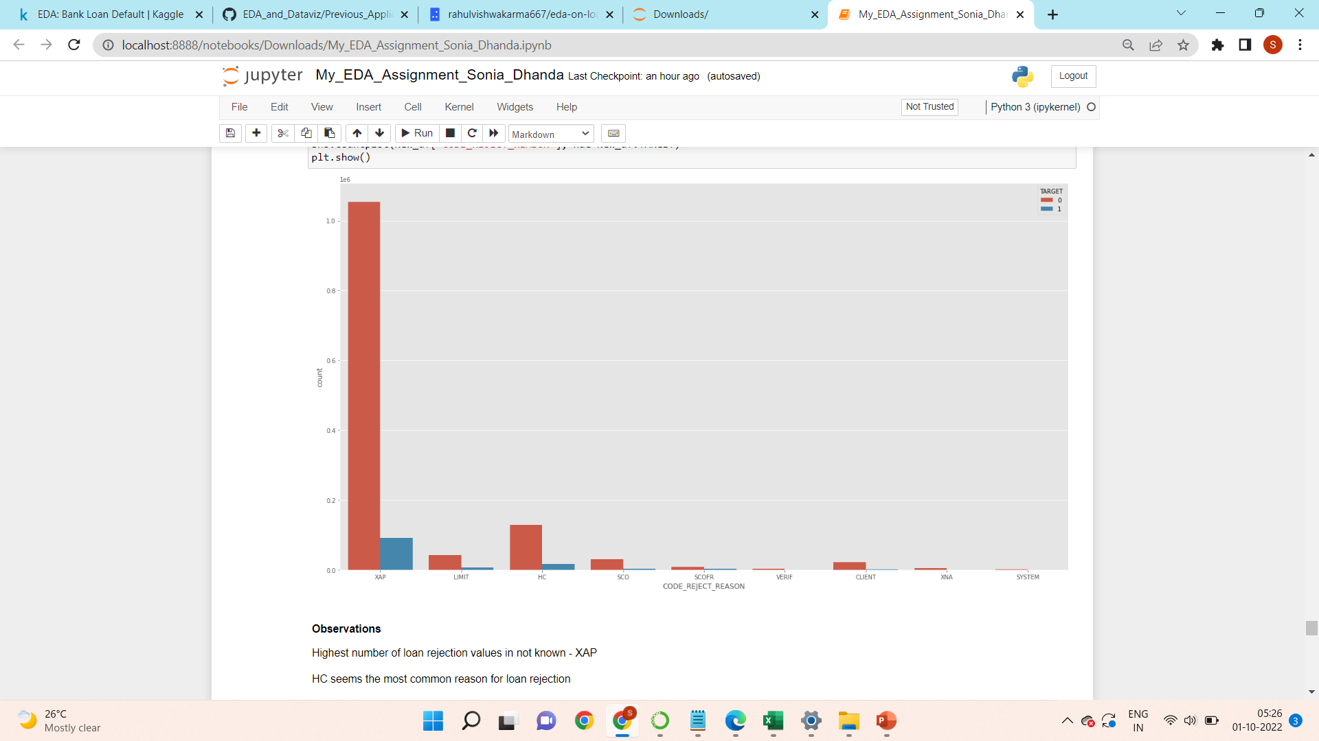

Slide 37
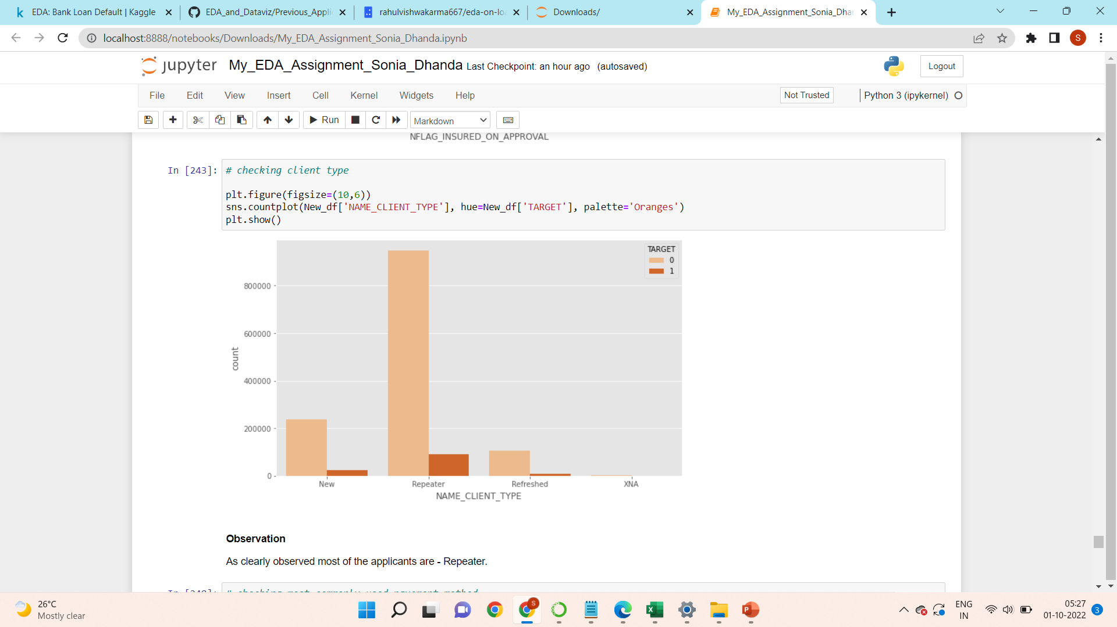
checking client type among Target customers

Slide 38
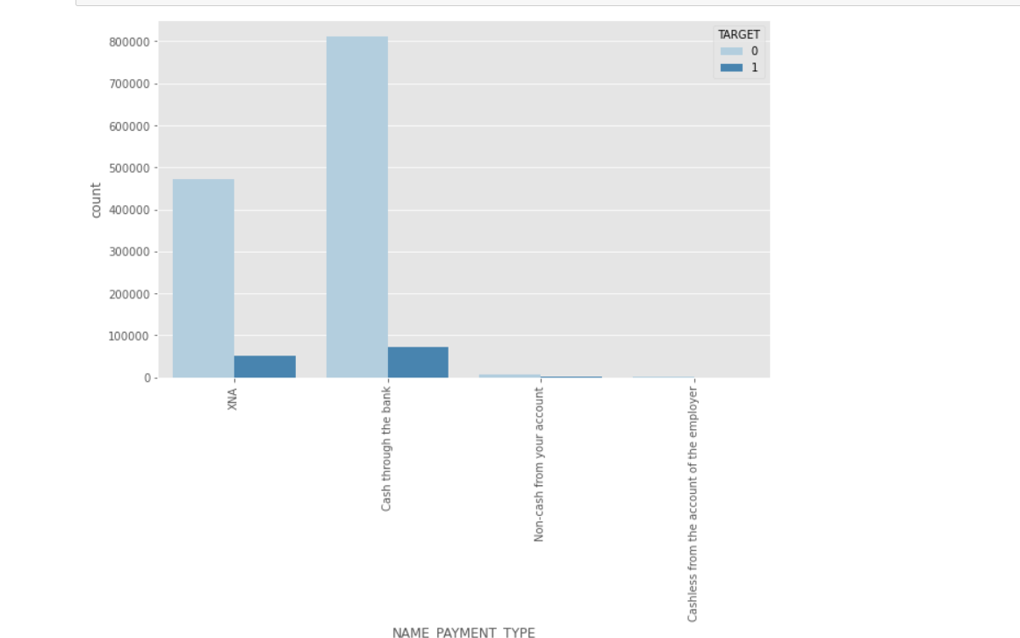
Checking most commonly used payment method
Observation
Most commonly used payment method is - Cash through the bank

Slide 39
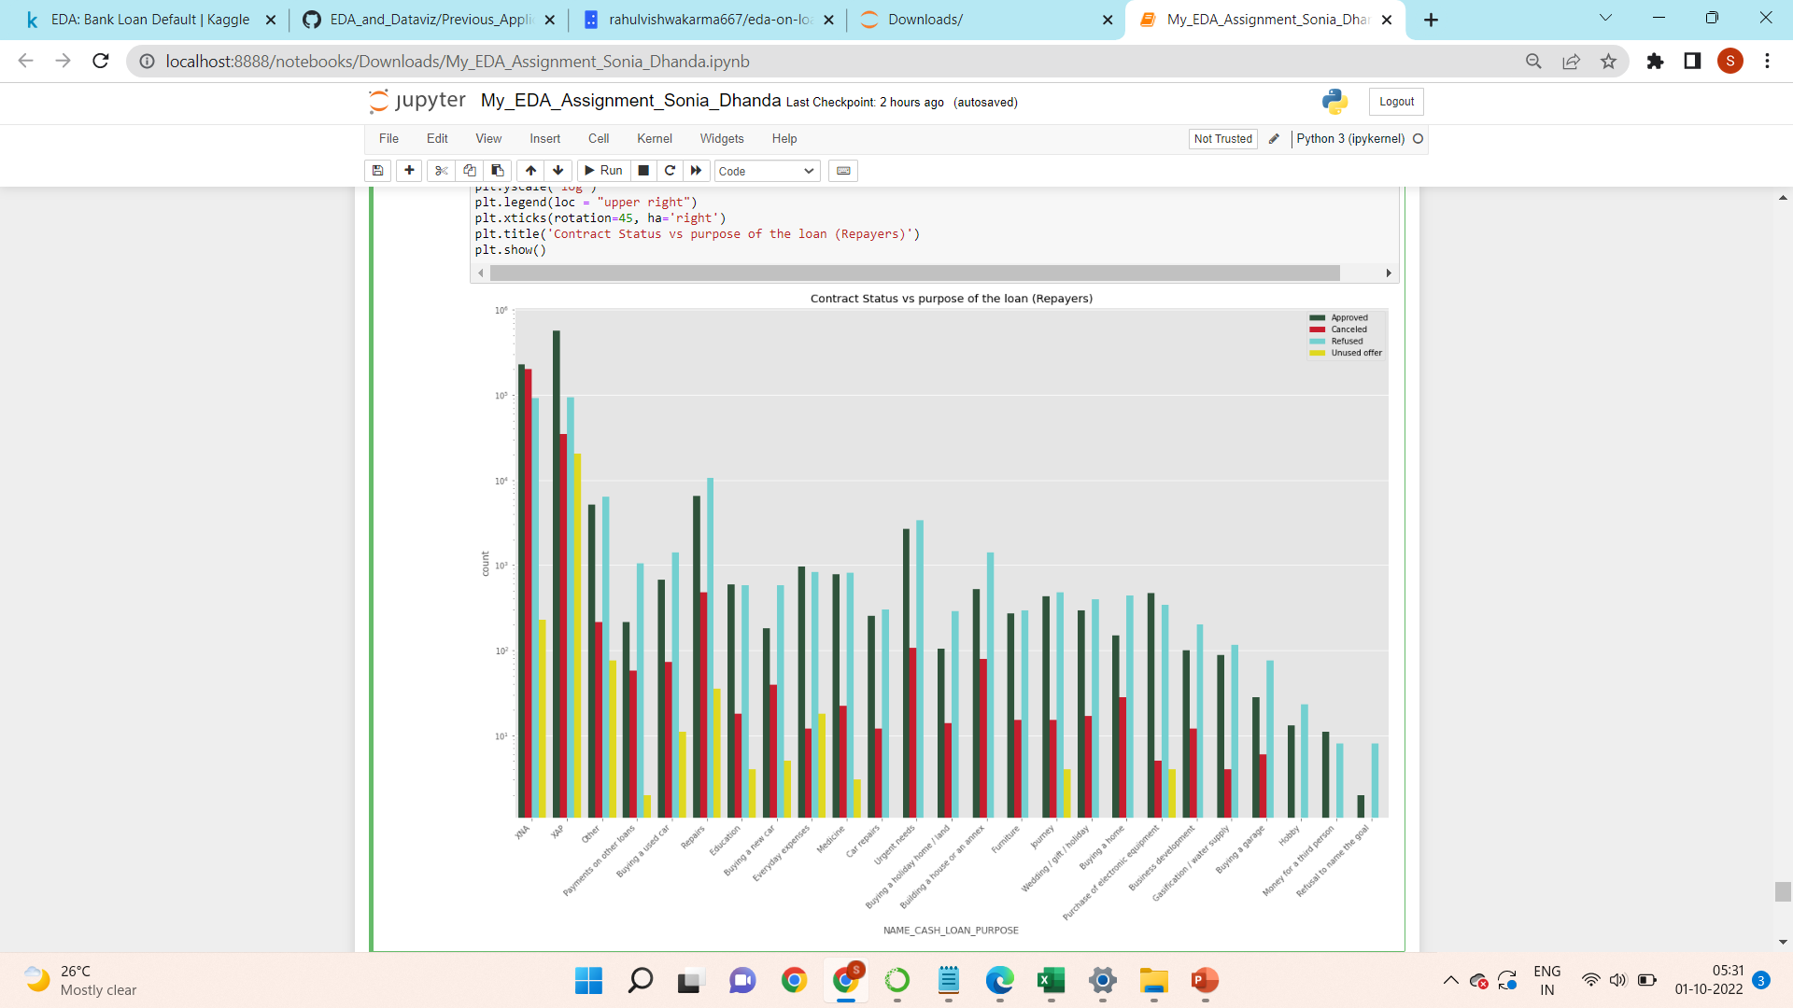
Plotting Contract Status vs purpose of the loan for repayers

Slide 40
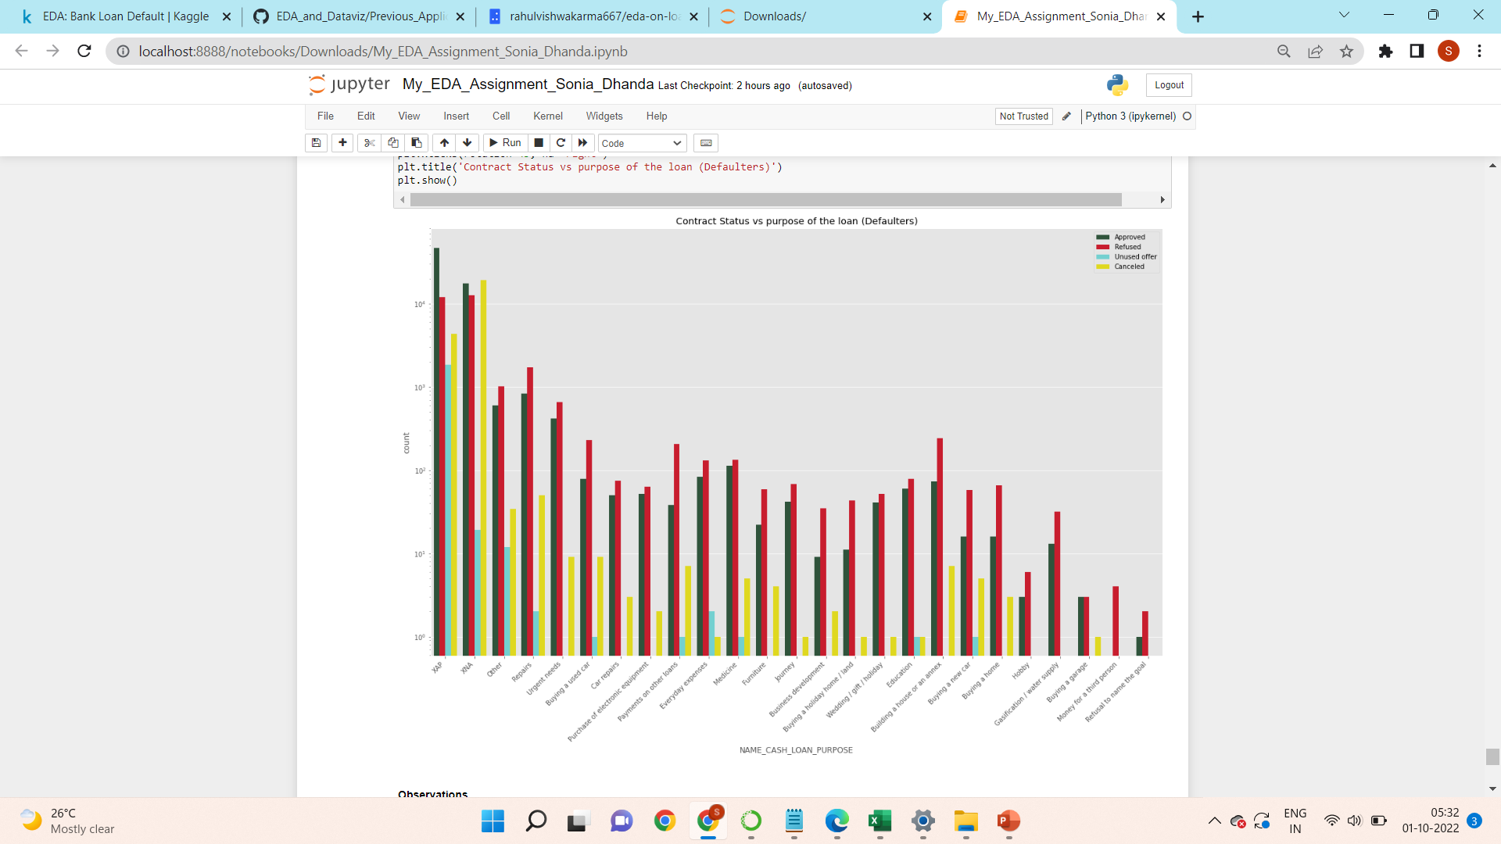

Slide 41
Observations
For Purpose of loan huge number of values are not known - XAP,XNA
Large number of applications have been refused.
People who have taken loan for Re-payres have highest default rate.
High number of applicants loan either rejected, cancelled or may bank have high interest rates which is not affordable.

Slide 42
Conclusion
When the company receives a loan application, the company has to decide for loan approval based on the applicant’s profile.
Two types of risks are associated with the bank’s decision:
If the applicant is likely to repay the loan, then not approving the loan results in a loss of business to the company
If the applicant is not likely to repay the loan, i.e. he/she is likely to default, then approving the loan may lead to a financial loss for the company.

Slide 43
So, after analyzing the two datasets, there are some findings & observations as follows : -
First & most important - Data is highly imbalanced among re-payers & defaulters -> we can not compare the two categories directly but can check each one individually with respect to other factors.
Highest number of customers fall under age group 35 yrs - 40 yrs & second highest under 40 yrs - 45yrs -> we can consider this age group while giving loan.
Most of the customers whether defaulter or re-payer prefer to take loan when credit amount of loan is less.
Occupation type - Laboure's are most likely to repay loan on time, on contrary to the HR staff who are less likely to make payment on time.
Female customers are likely to re-pay loan on time -> So banks can target more female customers for lending loan.
Customers who owns a house or apartment, also repay loan on time.
Working people are most capable of repaying loan on time -> can be targeted to lend loans.

Slide 44
Customers with secondary education repay loan on time as compared to customers with academic degree.
The married people mostly repay loan on time and can be considered safe to lend loan.
Most commonly used payment method is - Cash through the bank
Highest number of loan rejection values in not known – XAP
HC seems the most common reason for loan rejection
The people whose previous loans were approved are more likely to re-pay the current loan timely, than the people whose previous loans were rejected.
7% of the defaulters in current loan have previously approved loan application.
88 % of the re-payers in current loan have previously refused loan application.
High number of applicants loan either rejected, cancelled or may bank have high interest rates which is not affordable

Slide 45
Thank You

